Slide 1
PUBP309: EDUCATION POLICY
Shivakumar Jolad
FLAME University
Indigenous Education in 19th Century- Part II Prof. Parimala Rao

Slide 2
The Indigenous Education in India:
Access, Equity, Curriculum, and the British policies towards them
PROF. PARIMALA RAO

Slide 3
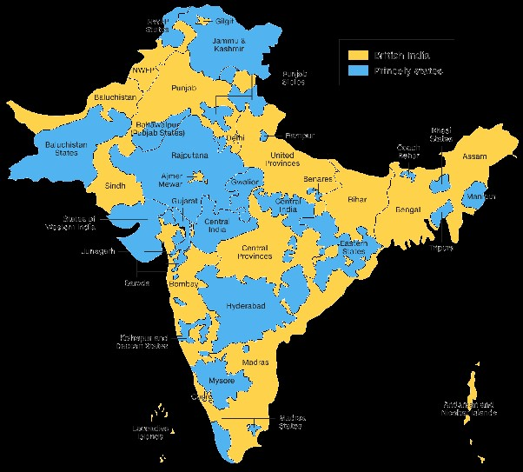
British 60% , 565 Princely States 40%

Slide 4
What do we know so far?
There are a number of myths surrounding Pre –colonial Indigenous education in India
1. Teaching and learning was oral
2. All teachers/Gurus were Brahmins
3. Informal, Conducted under trees
4. Teachers were members of the village community and received remuneration in kind like potters or iron smiths
5. It was destroyed by the British

Slide 5
WRITING TRADITION
India has produced 500 core texts, 1 lakh inscriptions, 12 widely used script
How can an oral tradition create this?
496 texts were taught through manuscripts / 4 Vedas in oral tradition
1. Gurukulas – higher education – 12-14 + years Sanskrit Pathasalas/tols – Sanskrit curriculum – sacred and secular- Vedas-Dharmasastras-Ayurveda, Kalidasa
2. Lipisalas – Prakrit reading, writing, arithmetic – vernacular pathasalas – Modern Indian Languages - reading, writing, arithmetic

Slide 6
When and Why the data was collected?
The British parliament earmarked 100,000 rupees for the promotion of education in India / the Charter Act of 1813. British liberals had campaigned for it.
1. 1768-70 Famine - 3 million died. Modern education would help peasants to adopt modern technology in cultivation-. Education is best defense against natural calamities - peasants can better protect themselves from famines
2. Modern education would help people give up superstitious practices like sati, and female infanticide
3. Indians with modern education could have a say in the adm
The government of India opposed ‘any interference in the internal affairs of Hindu society’ did not spend money during 1813-1821 – Sanskrit Colleges – Calcutta, Poona

Slide 7
Indigenous education- DATA COLLECTION
Sanskrit scholars and scholars of Indian languages collected the data on the Indigenous schools 1819-1838 to make the government to invest in education / support indigenous schools / build modern institutions
We have data of over 16,000 indigenous schools that can be tabulated.
We have data of several districts that cannot be tabulated.
For instance, in 1824, Evantt Baillie, the Judge of North Koncan wrote that 380 boys in schools in Thana district came equally from ‘Brahmin, Prabhu, Sutar, Bhandari and even coolies’
Without complete information, it is difficult to tabulate the data or prepare the tables.

Slide 8
The Earliest Data: Ratnagiri District 1819
Untouched by external influences
Thomas Best Jervis, a statistician Marathi scholar, was deputed to collect data on the number of villages, roads, rivers etc
He was interested in education, went to every school and collected information. So we have even the names of the teachers and caste of every teacher and student for this district
Jervis established the first teacher training institution in Ratnagiri in 1820In Village Pent, Baji Pant Marathe - Brahmin teacher taught 1 Brahmin, 6 Sonar, 1 Shimpi, 10 Bhandari, 4 Sali, 3 Mali, 6 Khatri, 1 Panchal boys in a shed that belonged to a Teli.
In Village Palee, Amrutrao Bhagwant- Prabhu caste taught 5 Brahmin, 6 Prabhu, 7 Sonar, 5 Kasar, 4 Maratha, 5 Shimpi, 3 Surekuree, 1 Jangam, 3 Jew, 7 Muslim boys in the village temple. 46 boys this was the most popular school in the district

Slide 9
Teachers and Students in Ratnagiri District 1819- Thomas Best Jervis
Castes | Teachers | Students
Brahmin | 33 | 567
Dominant castes - Prabhu, Vysya, Maratha, Lingayat | 40 | 418
Artisanal castes, Kumbhar, Kansar/Kasar, Simpi, Sonar, Bhandari, Mali, Teli, Sutar, Navi, Koli, Panchal, Dhangar, etc | 9 | 393
Total Hindu | 82 | 1,378
Muslim | 2 | 65
Jew | 2 | 25
Total | 86 | 1,468

Slide 10
Students in Gujarati and Kannada speaking areas 1824
Districts | No of Schools | Brahmin | Dominant Castes-Wani, Kunbi, Rajput, Marwari, Jain, Lingayat etc. | Artisanal Caste-Sutar, Mali, Kasar etc | Muslim | Total | Average no of students per school
Veeragram (140 villages) | 6 | - | 129 | 29 | - | 158 | 26.33
Ahmedabad (928 villages) | 84 | 410 | 1,772 | 791 | 68 | 2,973 | 35.39
Dharwar | 265 | 943 | 2,092 | 609 | 118 | 4,027 | 15.19
Belgaum | 86 | 212 | 637 | 186 | 14 | 1,049 | 12.19

Slide 11
Castes of Teachers in Bengal, Bihar, Orissa
Castes of teachers | Murshidabad | Birbhum | Burdwan | South Bihar | Tirhoot | Total
Kayastha | 39 | 256 | 369 | 278 | 77 | 1,019
Brahmin | 14 | 86 | 107 | - | 1 | 208
Baidya/Vaidya | 1 | 2 | 1 | - | - | 4
Kshatriya/Rajput/Aguri | 4 | 3 | 30 | - | - | 37
Banik/ Vysya | 1 | 10 | 8 | 1 | 2 | 22
Artisanal castes- Teli, Sonar, Tanti, Kurmi, Mali, Napit etc | 4 | 43 | 104 | 5 | - | 118
Dalit castes - Sunri, Kalu, Chandal, Pasi | 3 | 7 | 7 | - | - | 17
Total Hindu Teachers | 66 | 407 | 626 | 284 | 80 | 1,463
Muslim | - | 4 | 9 | 1 | - | 14
Total number of schools | 66 | 411 | 635 | 285 | 80 | 1,470

Slide 12
Castes of Students in Bengal, Bihar, Orissa
Castes of Students | Murshidabad | Birbhum | Burdwan | South Bihar | Tirhut | Total
Kayastha | 129 | 487 | 1,846 | 220 | 51 | 2,733
Brahmin | 181 | 1,853 | 3,429 | 256 | 25 | 5,744
Baidya | 14 | 71 | 125 | - | - | 210
Kshatriya Rajput, Aguri | 38 | 148 | 969 | 189 | 86 | 1,430
Banik/Vysya | 144 | 742 | 928 | 591 | 32 | 2,437
Artisanal castes, Sutar, Teli, Tanti, Napit, etc | 479 | 2,270 | 4,361 | 1,466 | 299 | 8,875
Dalit castes- Sunri Kalu, Dom, Chandal | 73 | 527 | 750 | 198 | 81 | 1,629
Total Hindu Students | 1,058 | 6,098 | 12,408 | 2,920 | 574 | 23,058
Muslim | 82 | 232 | 769 | 172 | 5 | 1260
Total | 1,140 | 6,330 | 13,177 | 3,092 | 579 | 24,318

Slide 13
Bengal, Bihar, Orissa
Teachers Total 1,470 teachers
Kayastha -1,019, Brahmin - 208 , Artisanal Castes - 118
Dalits- 17 (Murshidabad, Birbhum and Burdwan districts)
Students Total- 23,058
Brahmin 5,744, Non-Brahmins 15,685, Dalits- 1,629
Adam- ‘parents of good caste do not hesitate to send their children to schools conducted by teachers of an inferior caste and even of a different religion. ... this is true of the Chandal, and other low caste teachers enumerated.’
Village Upper Bazar in Nattore, in Rajshahi district, Naba Kishore Das, a 32-year-old Kaibarta taught in a school established by Gobinda Pal, an upper-caste Mahajan/ Chandi Mantap

Slide 14
Bardaman District 1838
Untouchable Castes | Indigenous Schools | Missionary Schools | Total
Kalu | 174 | 33 | 207
Sunri | 168 | 20 | 188
Bagdhi | 117 | 21 | 138
Dom | 58 | 3 | 61
Chandal | 60 | 1 | 61
Jalia | 28 | - | 28
Dhoba | 19 | 5 | 24
Muchi | 16 | - | 16
Hari | 11 | - | 11
Tior | 2 | 2 | 4
Lahari | 3 | - | 3
Garar | 2 | - | 2
Kahar | 2 | - | 2
Mal | 2 | - | 2
Maitya | 1 | - | 1
Pasi | - | 1 | 1
Total | 663 | 86 | 749

Slide 15
Madras Presidency 1822 Indigenous School Students (Kannada, Malayalam, Odia, Telugu, Tamil)
No of Schools - 11,691
Brahmin- 30,479
Vysya -13,772
Shudra - 75,324
All other Castes - 22,794
Total Hindu students – 1,42,369
Non-Brahmin students – 1,11,890
Muslim - 10,864 (5% of total population)
Total -153,233

Slide 16
Number of Schools and Students in the Madras Presidency
Districts | No. of Schools | Brahmin | Vysya | Shudra | All other castes | Total Hindu boys | Muslim boys | Total | Average per school
Arcot N | 630 | 698 | 630 | 4,856 | 538 | 6,722 | 552 | 7,274 | 11.54
Arcot S | 875 | 997 | 370 | 7,938 | 862 | 10,167 | 252 | 10,419 | 11.90
Bellary | 533 | 1185 | 981 | 2,998 | 1,174 | 6,338 | 243 | 6,581 | 12.22
Chengalpet | 508 | 858 | 424 | 4,809 | 452 | 6,543 | 186 | 6,729 | 13.24
Coimbatore | 763 | 918 | 289 | 6,379 | 226 | 7,812 | 312 | 8,124 | 10.64
Ganjam & Srikakulam | 255 | 808 | 243 | 1,001 | 886 | 2,938 | 257 | 3,195 | 12.52
Guntur | 574 | 3,089 | 1,578 | 1,923 | 775 | 7,365 | 257 | 7,622 | 13.27
Kadapa | 494 | 1,416 | 1,713 | 1,775 | 647 | 5,551 | 341 | 5,892 | 11.92
Madras | 305 | 358 | 789 | 3,056 | 313 | 4,516 | 143 | 4,659 | 15.27
Madura | 844 | 1,186 | 1,119 | 7,247 | 2,977 | 12,529 | 1,147 | 13,676 | 16.20
Malabar | 759 | 2,230 | 84 | 3,697 | 2,756 | 8,767 | 3,196 | 11,963 | 15.76
Masulipatanam | 434 | 1,693 | 1,108 | 1,506 | 470 | 4,777 | 275 | 5,052 | 11.64
Nellore | 804 | 2,466 | 1,641 | 2,407 | 432 | 6,946 | 617 | 7,563 | 9.40
Rajmundry | 291 | 904 | 653 | 466 | 546 | 2,569 | 52 | 2,621 | 9.00
Selam | 386 | 783 | 324 | 1,674 | 1,382 | 4,163 | 432 | 4,595 | 11.90
Srirangapatanam and Ganjam | 41 | 48 | 23 | 298 | 158 | 527 | 86 | 613 | 14.95
Tanjore | 884 | 3,180 | 222 + 369 K | 10,661 | 2429 | 16,861 | 933 | 17,794 | 20.12
Tinnevelly | 607 | 2,016 | - | 2,889 | 3,557 | 8,462 | 796 | 9,258 | 15.25
Tiruchirapalli | 790 | 1,198 | 229 | 7,745 | 329 | 9,501 | 690 | 10,191 | 12.90
Vishakapattanam | 914 | 4,448 | 983 | 1,999 | 1,885 | 9,315 | 97 | 9,412 | 10.29
Total | 11,691 | 30,479 | 13,772 | 75,324 | 22,794 | 142,369 | 10,864 | 153,233 | 13.10

Slide 17
NWP/UP 1851
British adm - 8 districts-Agra, Aligarh, Bareli, Etawah, Farrukabad, Mainpuri, Mathura and Shahjahanpur.
Mughal Emperor, the Nawab of Awadh, Rampur etc
These eight districts had 50 towns and 14,987 villages.
1,039 schools in these 50 towns, and 1,967 schools were scattered among 1,535 villages. Together they had 27,853 boys.
There were no schools in the remaining 12,987 villages.
Of the 21,342 Hindu boys, 6,614 were Brahmins, 10,429 non-Brahmin upper castes and 4,299 lower caste boys.
There were 5,491 Muslim students.
The Hindu teachers - 46.4% Kayasthas, 43.9 % Brahmin, 1.7 % Rajput, 1.8% Bania, and 6% artisanal castes.

Slide 18
All India Pattern Vernacular Schools
Vernacular Schools – 70-75% non-Brahmin students and teachers/ more than 35% were from artisanal caste/ OBC
Majority of teachers-Kayasth, Baidya, Lingayat, Pillai castes
Andhra and Gujarat majority of teachers were Brahmins
Brahmin students studying under non-Brahmin teachers was common. Teaching was not hereditary occupation
Schools were conducted in Temples, Sheds, and houses of rich persons/ No dedicated school buildings
Average number of students per school normally varied between 8 - 25/ Konkan 2/ Kaira 150
In South India, many indigenous schools had girls-3,344 Hindu and 1,240 Muslim girls - co-education

Slide 19
School timings
Schools worked for 12 hours, there were 2 breaks for morning and afternoon meals
The first session sunrise – 5/6 am till 9/10 am/ 1 hour break
The second session before 11 am to 2/3 pm/ 1 hour break
The third session before 3/4 pm to 6/7 / oil lamps
The schools functioned on the basis of lunar month of 30 days
The schools had holidays on Full moon, New moon, Ekadasi, Dwadashi as well as all important festivals Sankranti/Pongal, Ugadi, Deepavali

Slide 20
Curriculum
Books – Vernacular translations of Ramayana, Mahabharata, Amara Kosha, Pancha Tantra, Hitopadesa- Manuscripts
Bombay Punchopaikyan and Vidhurniti were taught in Marathi schools,
Karnataka, Someshwara Shataka, Jaimini Bharata
Madras Tirukural
‘Composition, grammar, literature, deciphering various handwritings, writing common letters, drawing up forms of agreements, writing petitions/
Arithmetic up to long division, - ‘cast up accounts and to draw out bill of exchange’, multiplication tables, village accounts
Gujarat- Arithmetic first

Slide 21
WRITING IN SCHOOLS
Writing was taught on the very first day at school
Sand boards- Plantain leaves- wooden boards- older students used hand made paper & palm leaves
A thick Calico cloth was dipped in rice starch and dried. It was dipped again in charcoal solution and dried. Soap stone cut into the shape of sticks were used to write on it.
Punishment was severe, caning was common
Fathers visited schools and monitored the progress / Mothers enquired the teachers about the progress of their sons
Children began the school 5-6 yrs/completed 13-14 yrs
Nobody failed, Bright children took 4 years, average children 6 years, below average 8 years to complete the course of instruction.

Slide 22
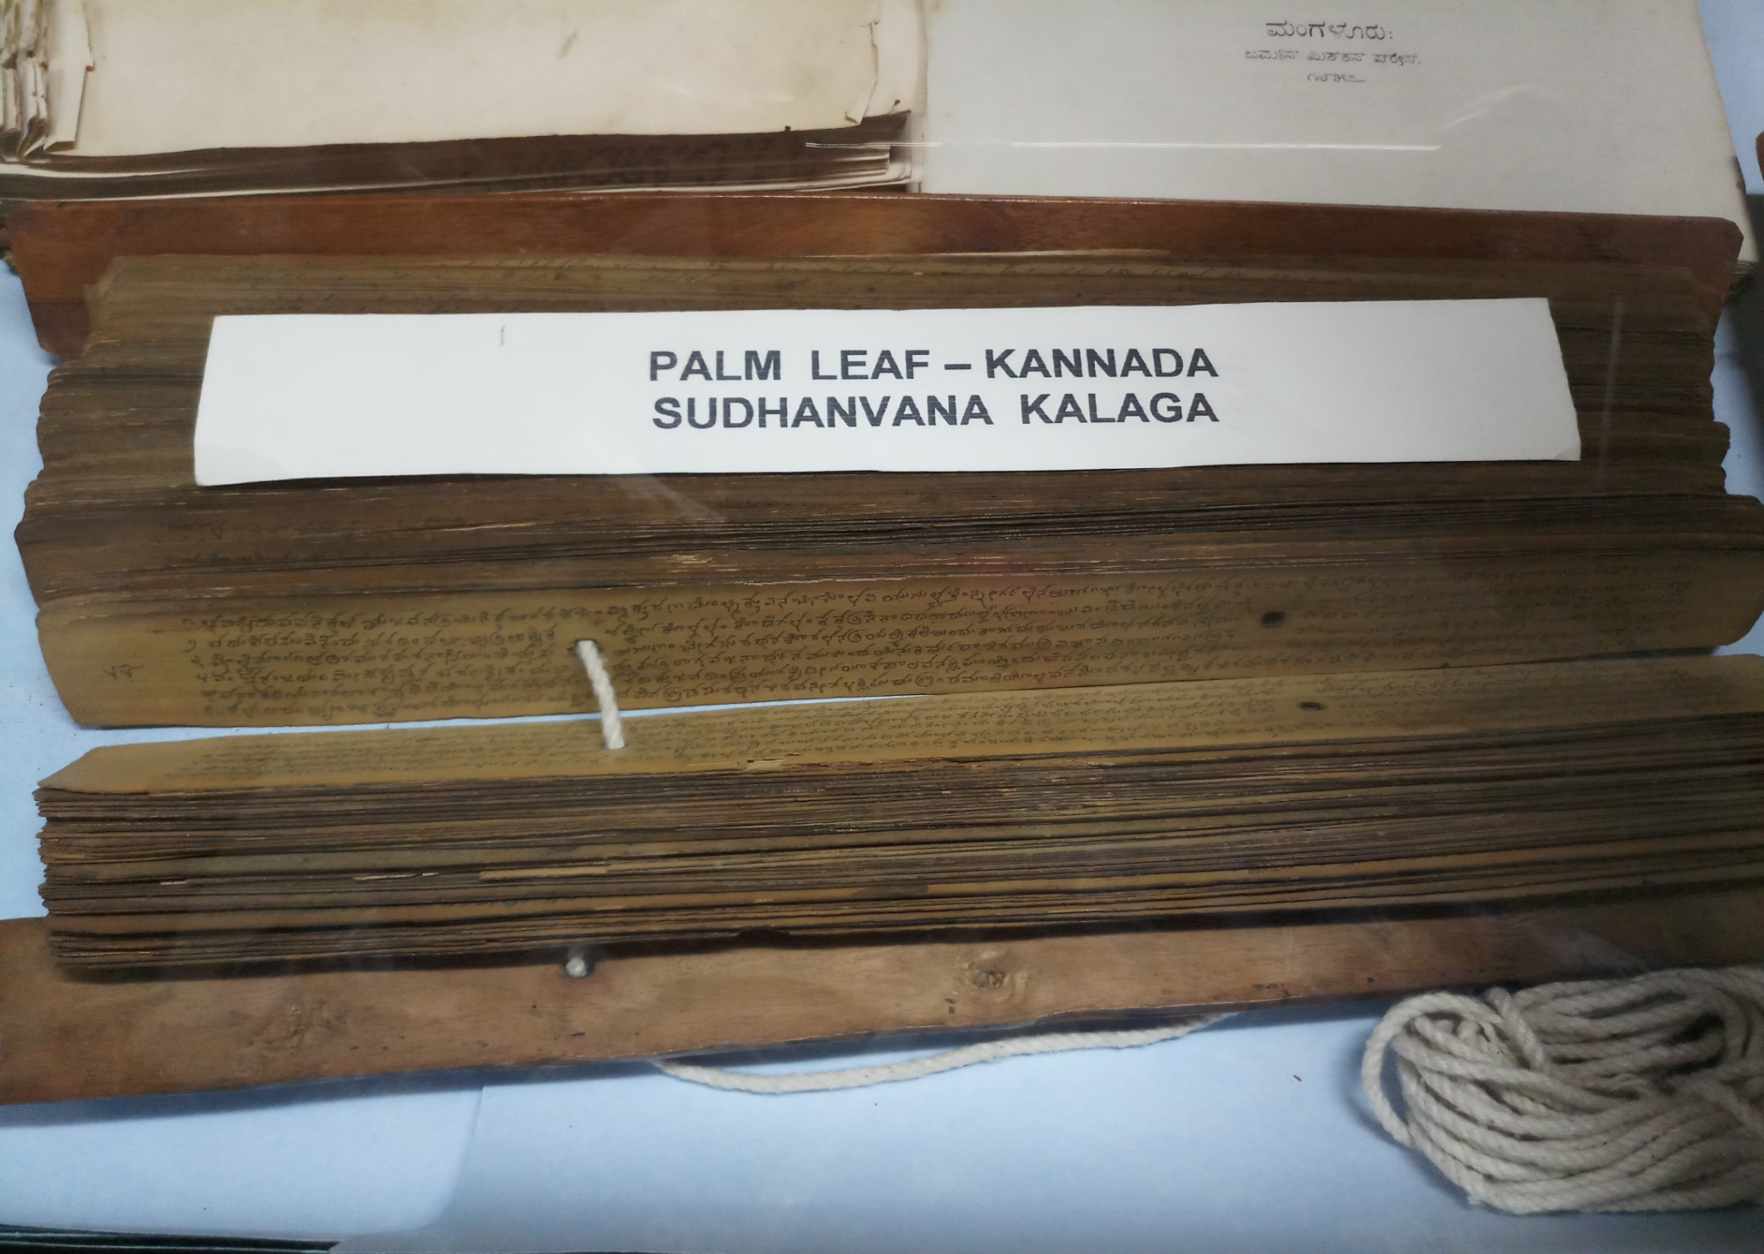

Slide 23
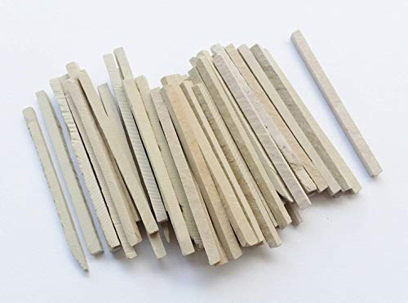
Soap stone sticks Batti/Balapa/Khadi

Slide 24
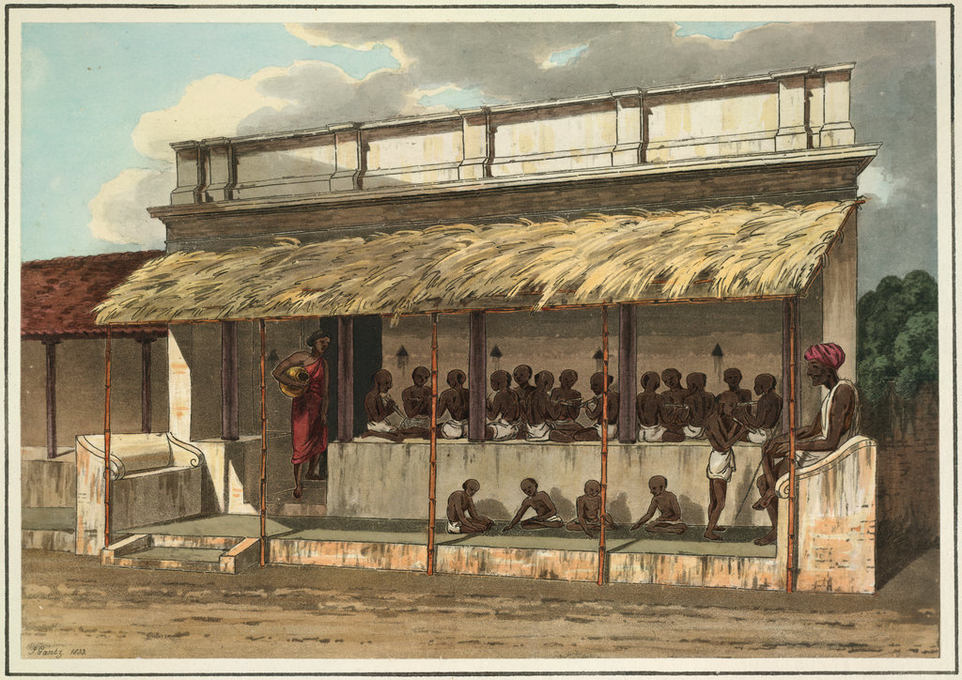

Slide 25
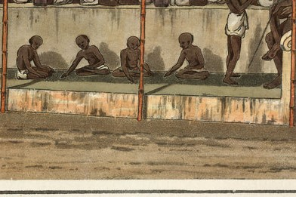

Slide 26
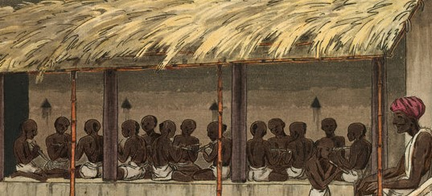

Slide 27
Income of Teachers-fee in Cash
Students paid anywhere between 1-8 annas a month as school fee
Lowest was in Talwandi in Punjab 1 rupee 2 annas
Bihar- 1 rupee 12 anna and 9 pisa a month
In Bengal it was 3 rupees 12 annas 3 pisa per month
In Bombay it was 6 rupees
Lahore and Kasur 7 rupee 8 anna to 8 rupee 8 anna
South India 6-8 rupees
Gujarat 2 rupees at every stage - large classes
Teachers received gifts Deepavali, marriages /local produce

